Slide 1
Sentiment Analysis EBC 6300- Fundamentals of Applied Data Science
Manpreet Singh Bhatia- 300110973
Bharath Battula - 300110122
Krishna Chaithanya Reddy - 300103716

Slide 2
AGENDA
Understanding our needs as to why Sentiment Analysis is required.
Problem statement that we worked on.
Strategies and methods used in capturing the data required for Sentiment Analysis.
Challenges we faced when gathering the data.
What we achieved after the sentiment analysis is completed and how it benefits to the society.
Bibliography/References.

Slide 3

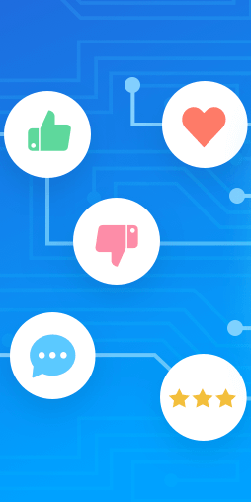
What is Sentiment Analysis
Sentiment analysis is the study of the sentiments, attitudes, emotions,
compliment and opinions towards an entity or object (product, service)
or a topic [1].
It has been shifted from analyzing the review of the customers for a
product bought online to analyzing the tweets and the posts of the
users on social media like Twitter, Facebook and LinkedIn etc.

Slide 4
Why Sentiment Analysis
It is used to know the public opinion over a topic.
It can be used in E-Commerce business to the reputation of brand and customers preferences.
It can be used individually to know the reviews of a particular product before buying it.
It can also be used in research topics like predicting election results, predicting box office and so on….
Applications of Sentiment Analysis is vast…
Some of the recent applications of it are:
Expedia Canada.
Obama Administration.

Slide 5
Problem Statement
The problem in Sentiment Analysis is classifying the polarity of a given text at the document, sentence level.
Given a message or post, decide whether the message is of positive, negative, or any of other sentiments/emotions.
Case study is General Elections of Canada, 2019.
System Requirements
R-Studio Cloud
Twitter Authentication to access API

Slide 6
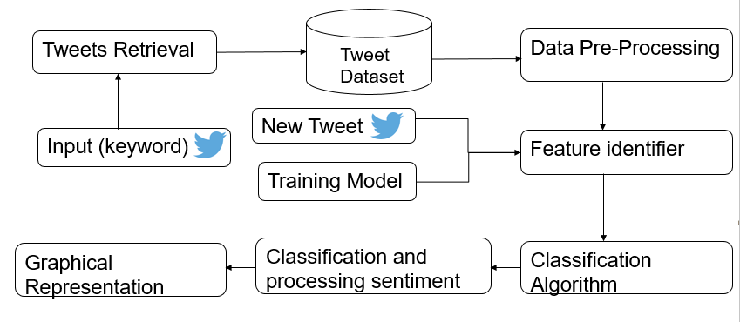
Project Framework

Slide 7
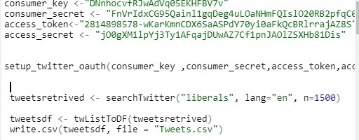
Data COllection
The data collection process will use Twitter Data streaming API to collect the data. For that, we will define the keywords. In our case it would be related to Canadian General Election 2019.
Below is the snippet of the code in R used to retrieve the tweets

Slide 8
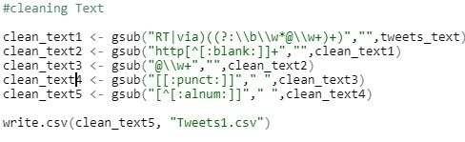
Data Pre Processing
Each individual tweet collected will be pre-processed. There are different stages to pre-process which are defined as:
Removal of images, URL's, usernames, emoji's and non-ASCII characters from the tweet.
Removal of punctuation as it won’t make any difference in identifying sentiment analysis.
Below is the snippet of the code in R used for data pre-processing.

Slide 9
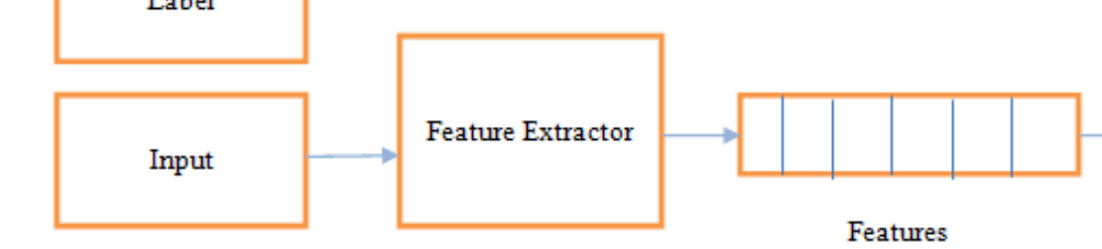
Feature Extractor
Polarity of the tweet.
Count of positive/negative words.
Count of different emotions and assign scores.
Positive/Negative special POS tags Polarity Score.

Slide 10
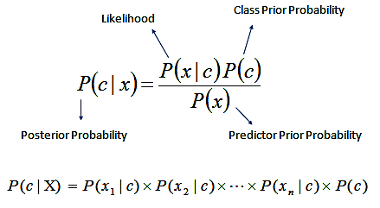
Classification Algorithm
Naïve Bayes classifier is proven as the best and successful algorithm to classify the text documents where text document can belongs to one or more classes [4].
We are using this classifier in our project to analyze the tweets(textual data) and categorize them into different classes such as positive, negative and neutral. The Bayes hypothesis is the process of calculating for differentiating happening P(a/b) from P(a), P(b) and P(b/a) as:
P(a/b) = [P(b/a)*P(a)]/P(b).
WHY NAÏVE BAYES?????????????????

Slide 11
An Example
Consider a sentence : The movie was great!!
Step 1: Tokenization - The, Movie, Was, Great, !, !
Step 2: Cleaning the data - The, Movie, Was, Great.
Step 3: Removing stop words - Movie, Great
Step 4: Classification - Movie - +/-, Great - +/-
Step 5: Applying Naïve Bayes - Movie - 0, Great - +1
Step 6: Calculation of polarity - +1
Based on the polarity score, we can classify the sentiment of the particular sentence.

Slide 12
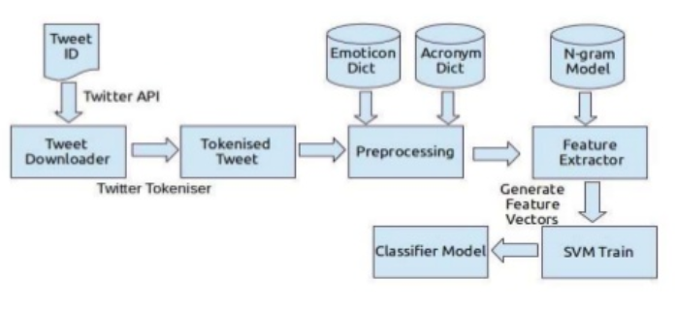
Training the Naïve Bayes Model
Img source: https://www.slideshare.net/SunilKandari2/twitter-sentiment-analysis-60967789

Slide 13
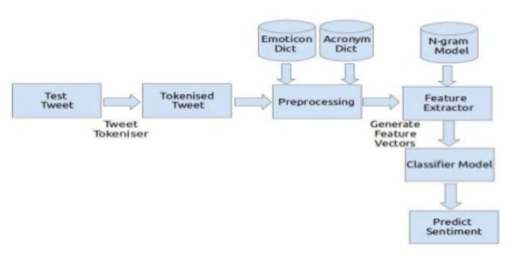
Testing the Naïve Bayes Model
Img source: https://www.slideshare.net/SunilKandari2/twitter-sentiment-analysis-60967789

Slide 14
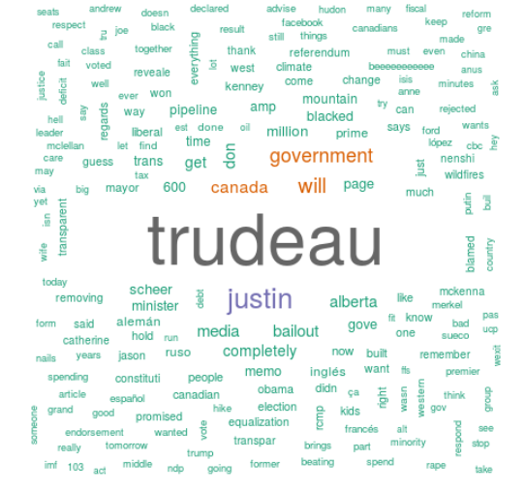
Results and Analysis
Word Cloud
A Word Cloud is text mining method to find the most frequently used words in a text.
It is a great communication and visualisation tool.

Slide 15
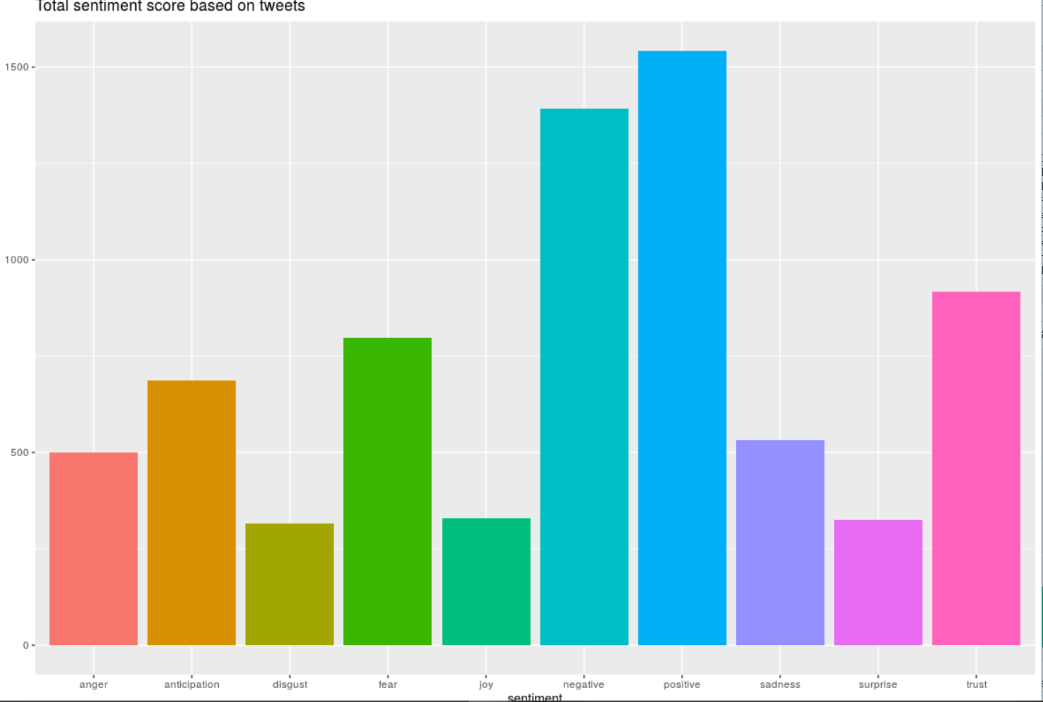
Results and Analysis

Slide 16
Challenges We faced
We were unable to detect sarcasm in the tweets
Couldn’t analyse emotions of images
Couldn’t process tweets in local language.
Couldn’t load the tweets for more than 7 days.
Future Work
Detect Sarcasm
Analyse emotions for images
Add any local speaking language to the data set
Find number of mentions of a particular topic and analyse its emotions
Parallelizing code

Slide 17
Summary and Concluding marks
We have implemented our Sentimental Analysis on twitter data set regarding General Elections Canada, 2019.
We have identified that Trudeau had positive support from the sentiment of the twitter users.
Sentimental analysis can be used to predict the sales of the products, services quality that is experienced by the customers.
Future Scope of Sentimental Analysis is getting increased day-by-day across all the social media networking sites.
It can also be used in Digital Marketing, E-mail Marketing.

Slide 18
Going Home
Bring to mind something you appreciate about what you just heard
Google about it and if it is fascinating, join us in the research……..☺

Slide 19
References
Dynamic Large Scale Data on Twitter using Sentiment Analysis and Topic Modelling Case Study: Uber by Andry Alamsyah , Wirawan Rizkika, Ditya Dwi Adhi Nugroho, Farhan Renaldi, Siti Saadah
Sentiment Analysis on Twitter Data-set using Naïve Bayes Algorithm by Hum Parveen, Shikha Pandey
Naive Bayes Classification for Sentiment Analysis of Movie Reviews by Rohit Katti.
https://github.com/Twitter-Sentiment-Analysis/R\
International Journal of Innovative Technology and Exploring Engineering (IJITEE) ISSN: 2278-3075, Volume-8 Issue-8 June, 2019- by Kavya Suppala, Narasinga rao
Aspect-based sentiment analysis to review products using Naïve Bayes , Mohamad Syahrul Mubarok, Adiwijaya, and Muhammad Dwi Aldhi, 2017
International Journal of Advance Engineering and Research Development (IJAERD) Volume 4, Issue 11, November-2017
Easy Steps to Learn Naive Bayes Algorithm with codes in Python and R by Sunil Ray.

Slide 20
THANK YOU!
Any questions? Thoughts? Observations?
You can contact us at
kbach021@uottawa.ca -613 276 3848
bbatt027@uottawa.ca - 343 987 5634
mbhat078@uottawa.ca – 343 997 4225

